Slide 1
Intro Regular Expressions in Powershell
Mark Hutchinson
RTPSUG meetup
2018-11-14
*There will be demos

Slide 2
Intro – What's In Common
Dir /b /s *.ps1
Dir /ad /s powershell*
Dir Q_*.xls?
Findstr /s powershell
Findstr /C:"powershell v"
findstr /I /r "marktest$"
Select * From master
Where MRN Like "[A-Z]#####"
Or MRN Like "[A-Z][A-Z]####"
Or MRN Like "D#######"

Slide 3
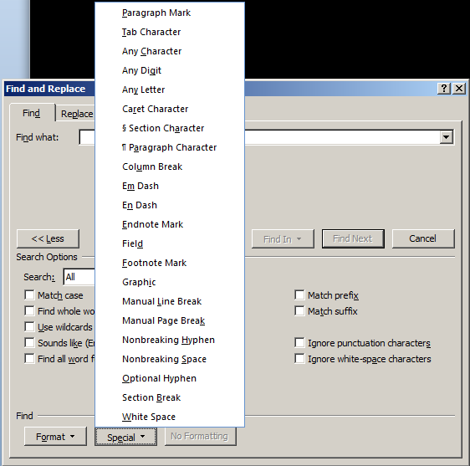
Regular Special menu

Slide 4
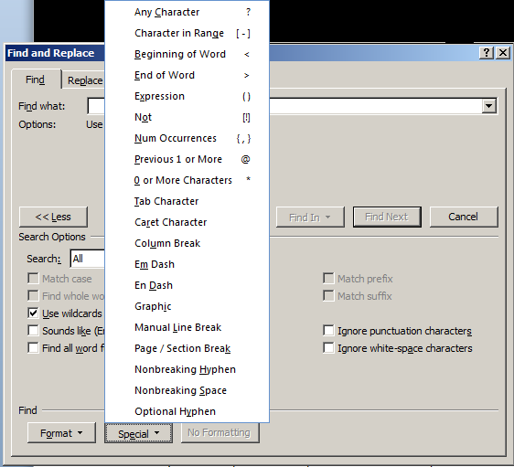
Wildcard Special menu
Notes:
Before I go to the next slide, does anyone have an answer to the question of what these have in common?

Slide 5
Intro - Answer
A:
Textual pattern matching
But Mark…
What does that have to do with the topic of your presentation?
What about regular expressions?
Why so many rhetorical questions on your slides?

Slide 6

Huzzah! Regular Expressions are pattern-matching on steroids
Notes:
PS fully supports regular expressions in lots of places and ways.

Slide 7
Matching Operators & $match
-match and -cmatch
$matches = special variable
-notmatch and –cnotmatch
Select-String –AllMatches
Also (but not in demos):
[regex]
System.Text.RegularExpressions

Slide 8
Replace Operators & Warnings
-replace and -creplace
Not to be confused with .Replace() method of string objects
-Like is 'regex-lite' – a good performer, but limited in its matching power.

Slide 9
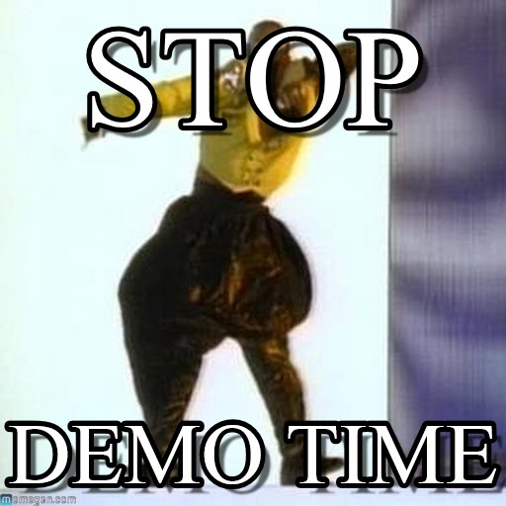
It's Demo time

Slide 10
Matching Used Here
If
Where
Switch
While
Param (on your function defns)
ValidatePattern()

Slide 11
Regex Quick Reference
ASCII letters and numbers – what you'd expect
Special Regex chars:
. - wildcard, except \n
\ - escape and back reference (followed by 0-9)
( ) - grouping, capturing or other
* - repeat prior item zero or more times
+ - repeat prior item 1 or more times
{ m, n } - repeating prior item m to n times

Slide 12
Regex Quick Reference
Special Regex chars:
? - braking and grouping exception
[ ] - characters and ranges
^ - start of string or not in [ ]
$ - end of string
| - alternation: (this|that|these)

Slide 13
Regex Quick Reference
Special Regex patterns:
\w - [0-9A-Za-z_]
\W - not \w
\d - [0-9]
\D - not \d
\s - any 'space' (not-printing) character
\r, \n, \t, \f, " "
\b - boundary between \w char and \W
___________________________
Note: not a complete list

Slide 14
It's Demo time again

Slide 15
The Rabbit Hole (avoided)
Time precludes a complete coverage of regular expressions.
I didn't cover repeating groups.
I didn't cover .Net regex pattern perks
I didn't cover performance issues.
I didn't cover the .Net framework regular expression object you can easily cast with [regex]

Slide 16
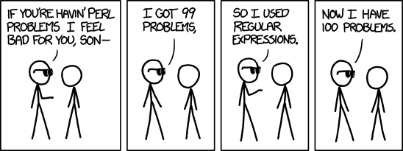
I will leave you with this from xkcd 1171

Slide 17
Advice & Conclusion
-c preferred over -i
Beware of number patterns
I've introduced regular expressions and shown how they're used in PS
I've shown you examples in my demos
Thank you
Questions?
Mark Hutchinson
aikimark@aol.com

